Slide 1
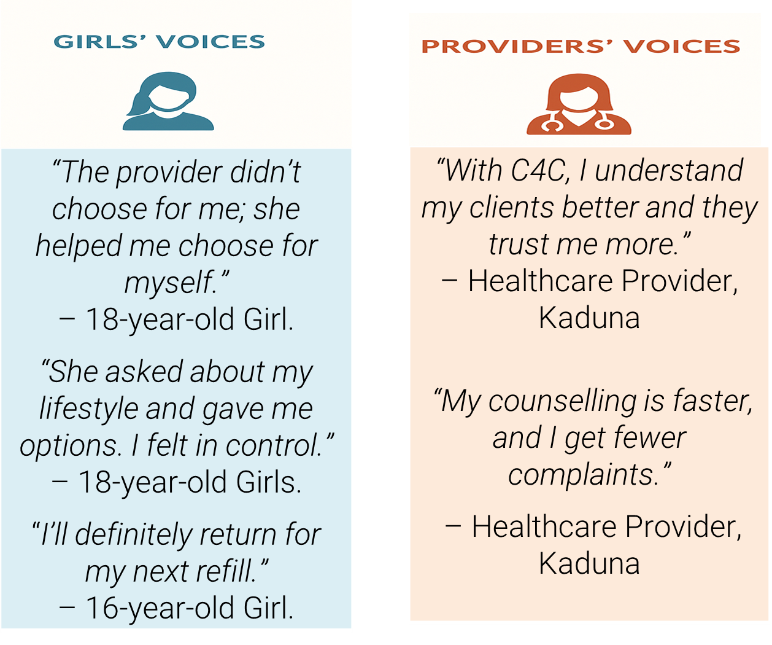
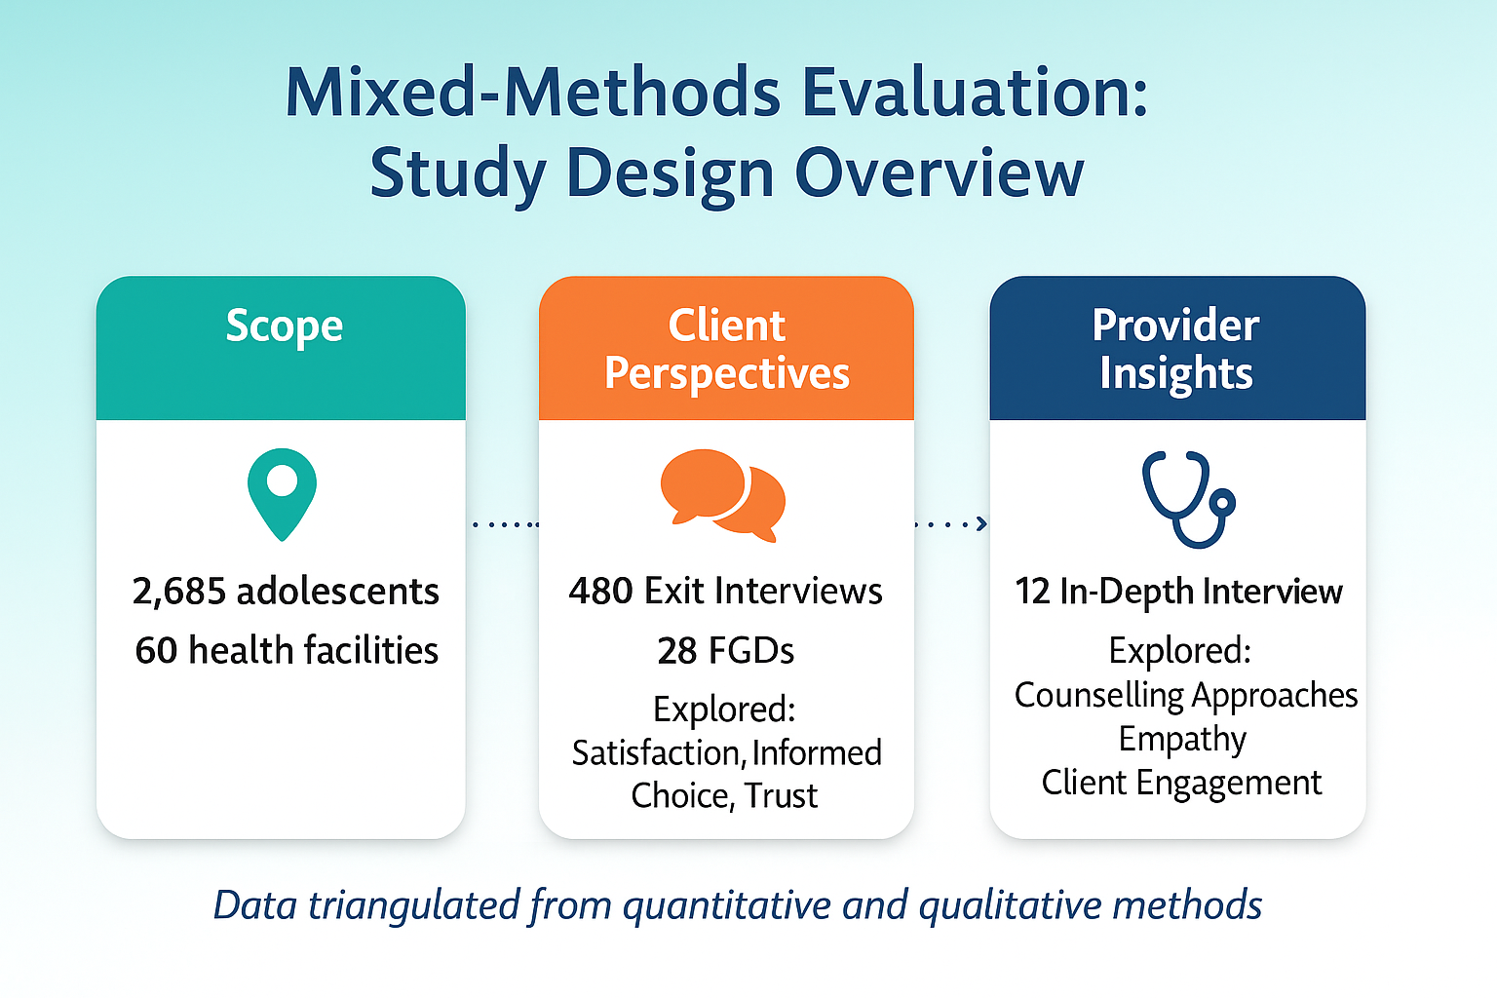



Sustaining Use Through Voice and Choice: How Structured Counselling Improved Contraceptive Continuation Among Married Adolescents in Nigeria
AUTHORS
Fifi Oluwatoyin Ogbondeminu¹, Alhaji Bulama², Beatrice A. Syomiti¹, Winnie Musubika¹, Abimiku Manasseh²
Author Affiliations:
¹ Population Services International
² Society for Family Health
BACKGROUND
In Northern Nigeria, only 3.3% of girls aged 15–19 use modern contraception and 15% have already begun childbearing. For many, fear of side effects and stigma drives discontinuation. Through A360, PSI introduced C4C to reframe counselling as a respectful conversation, not persuasion, but anchored in empathy, tools like the Choice Book and NORMAL guide help girls feel informed, supported, and in control.
PROGRAM INTERVENTION / ACTIVITY
62 providers in 30 facilities received C4C training, mentorship, and job aids. The approach centered empathy, shared decision-making, and side-effect preparedness, shifting power to married adolescent girls. Outcomes were compared with non-C4C sites.
METHODOLOGY
A mixed-methods evaluation compared C4C and non-C4C sites to assess impact on quality and continuity of care. Data sources included:
Service records from 60 facilities covering 2,685 adolescents (424 pre- and 2,261 post-C4C).
Client exit interviews with 480 married girls (15–19) assessing satisfaction, informed choice, and perceived empathy.
In-depth interviews with 12 providers and 28 FGDs with adolescent clients.
LESSONS LEARNT
Client-centered counselling creates voice and choice. Girls want to be part of the decisions about their bodies and need providers who will ask, listen, and guide.
Anticipatory side-effect counselling is a game-changer. Tools like NORMAL reframe fear as preparation, equipping girls to manage it and not stop it.
Provider transformation is key. C4C doesn’t just improve skills, it reshapes provider attitudes. Many providers reported deeper client relationships, faster service, and fewer complaints.
Key indicators included: Continuation rates, MII+, Perceived empathy, Autonomy, and Side-effect preparedness. This triangulated approach illuminated both measurable outcomes and the lived experiences shaping contraceptive continuation in a context of early marriage and low uptake.
PROGRAM IMPLICATIONS
To sustain and scale impact, PSI recommends
Embedding C4C in national training curricula and family planning guidelines.
Leveraging digital platforms to cascade training and mentorship.
Integrating C4C tools into routine adolescent reproductive health services.
RESULTS
C4C brought about a quiet transformation in how married adolescents experience care.
Continuation increased from 191 to 1,975 users in C4C sites, vs 233 to 266 in control sites.
98% understood their follow-up plans;
97% received clear method explanations;
61% felt fully informed to make their own decision
Providers reported better relationships, faster service, and fewer complaints.
C4C-trained providers were 8× more likely to retain clients due to greater trust, clarity, and autonomy.
CONCLUSION
C4C is more than a counselling tool, it’s a shift in power. In Northern Nigeria, where adolescent girls often lack voice in their reproductive choices, C4C enables them to leave the clinic with clarity, confidence, and control. By centering counselling on girls’ voices, anticipating side effects, and transforming provider attitudes, C4C builds trust and strengthens care. When care is centred on her, she doesn’t just choose contraception, she continues it.
VISIT US
PSI.ORG
LIKE US
PSIHEALTHYLIVES
FOLLOW US
POPULATION-SERVICEINTERNATIONAL

