Slide 1
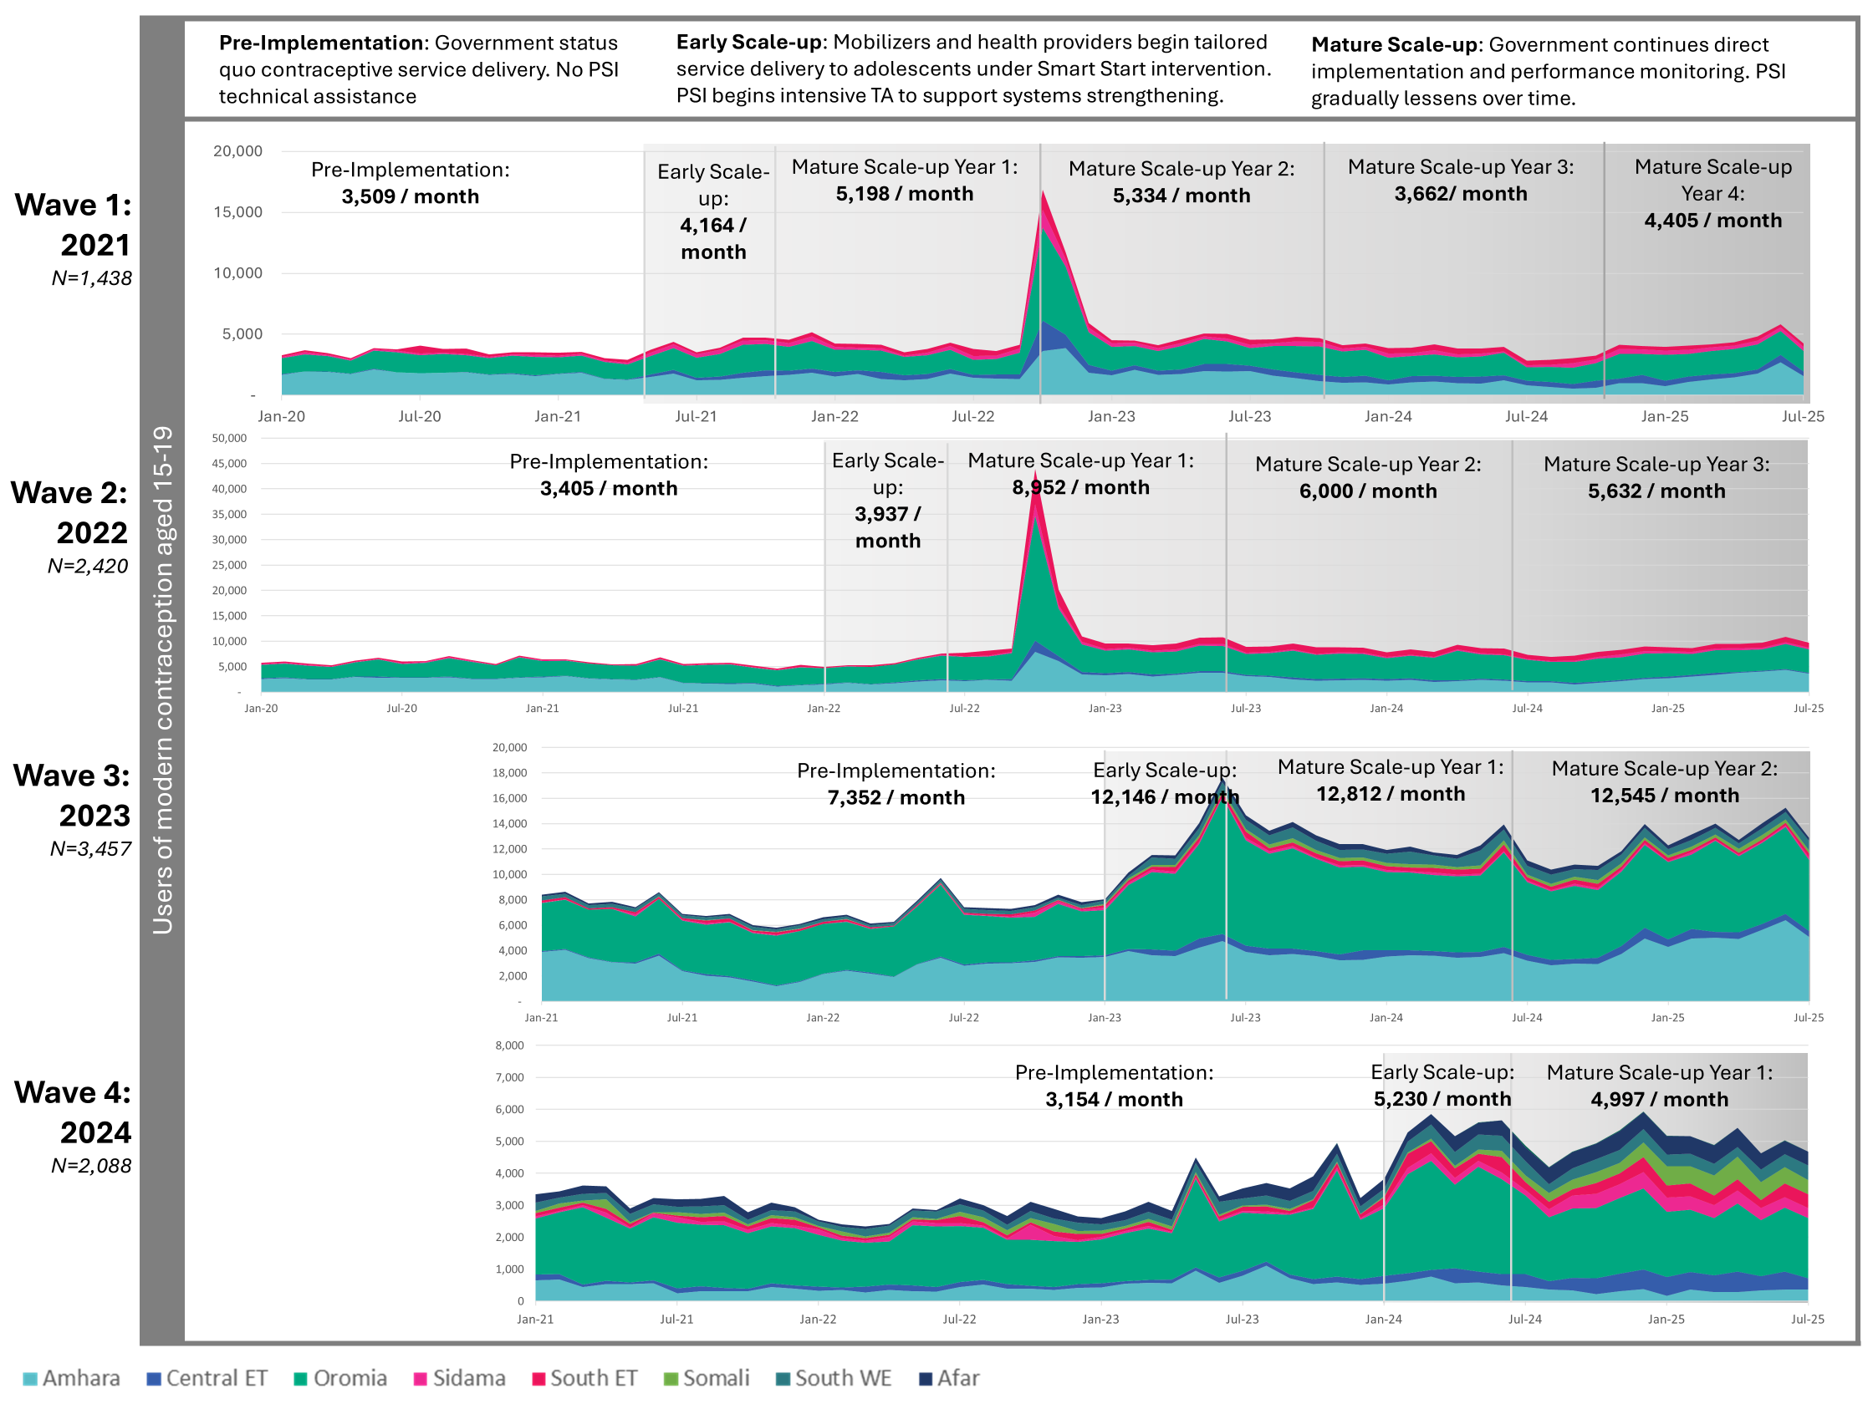




RISE in Ethiopia: Advancing Equitable Access to Family Planning for Married Adolescents at Scale
AUTHORS
Bekele Belayihunª, Mary Phillips^{b}, Meghan Cutherell^{b}, Katherine M. Anfinsonª, Rahel Wasihunª, Rahel Demissewª, Seyoum Atlieª, Dorothy Balabaª
Author Affiliations: a Population Services International, Addis Ababa, Ethiopia; b Population Services International, Washington, DC
BACKGROUND
Adolescent girls in Ethiopia face serious reproductive health challenges due to early marriage and childbearing. Smart Start, a government-led initiative supported by PSI Ethiopia, integrates family and financial planning counseling for married adolescent girls and their husbands. Embedded in the primary health care system , it equips health workers with tools to deliver age-appropriate services. Under the leadership of the Ethiopian MOH, Smart Start was scaled to over 9,231 health posts beginning in 2021. In 2024 the MOH put forward an additional plan to scale Smart Start to 100% of health facilities by 2027, contributing to its goal of a 3% reduction in teenage pregnancy by 2030.
METHODS
We analyzed data from government health management information systems (HMIS) on contraceptive services for adolescent girls (15–19) in Smart Start implementation sites from the period 2021-2024. Using DiD and interrupted time-series methods, we assessed uptake trends and spillover effects among women aged 20–24. Findings show increased adolescent contraceptive use and program impact during early and mature scale-up phases.
RESULTS
Rapid scale-up: Smart Start reached nearly half of Ethiopia’s woredas (46%) in four years (61 woredas in 2020 to 421 in 2024), demonstrating strong coverage.
Increased adolescent FP use: Over half a million adolescent girls took up a method of contraception for the first time, with growing numbers of repeat users demonstrating access over time.
National impact: 27% of new FP users; most national adolescent FP use occurred in intervention areas, this shows the program is driving national impact for this age group. Intervention areas represented 94.9% of the national total
Health post access: Monthly adolescent contraceptive users per health post rose from 1 to ~3, indicating services are being effectively accessed at the HP level.
Beyond intervention: Smart Start also reached 112k youth aged 20–24, extending impact beyond adolescents.
CHART KEY MESSAGES
507,954 new users aged 15–19
419,114 repeat user visits among girls aged 15–19
KEY MESSAGES
📈 Wave 1 (2021 Sites)
+49% increase in monthly users — from 3,509 (~0.5 per HP) → 5,198 (~0.8 per HP).
showing steady adoption and sustained government ownership.
📈 Wave 2 (2022 Sites)
+76% increase in monthly users — from 3,405 (~0.5 per HP) → 5,982 (~0.9 per HP) after a rapid early surge.
strong early uptake and effective transition to government-led implementation.
📈 Wave 3 (2023 Sites)
+71% increase in monthly users — from 7,352 (~0.7 per HP) → 12,545 (~1.3 per HP).
reflecting high efficiency/ readiness from prior learning.
📈 Wave 4 (2024 Sites)
+58% increase in monthly users — from 3,154 (~0.6 per HP) → 4,997 (~1.0 per HP) in the first year.
strong start and promising growth trajectory as scale-up continues.
Overall, the trend analysis showing strong, sustained program impact on adolescent FP access and uptake
SPILLOVER EFFECTS BEYOND ADOLESCENTS (2021–2023)
The intervention not only benefited adolescents but also had a measurable spillover effect among young adults aged 20–24...
Intervention Areas: +246,200 new FP users aged 20-24
Control Areas: +133,993 new FP users aged 20-24
Net Impact (Difference-in-Differences):
✨ +112,207 new users attributable to the intervention/ 45% greater increase in intervention areas
📊 Statistically significant (p = 0.001)
LESSONS LEARNED:
🏛️System integration and government ownership are critical to sustainability and scale.
📊Routine HMIS data can effectively track program reach and support adaptive management in real time.
🤝Community engagement and tailored technical assistance strengthen implementation quality and service equity.
🔁Flexible strategies, continuous monitoring, and shared accountability between implementing partners and government actors facilitate successful sustainable scale-up.
VISIT US
PSI.ORG
LIKE US
PSIHEALTHYLIVES
FOLLOW US
POPULATION-SERVICEINTERNATIONAL
Bbelayihun@psiet.org

