Slide 1
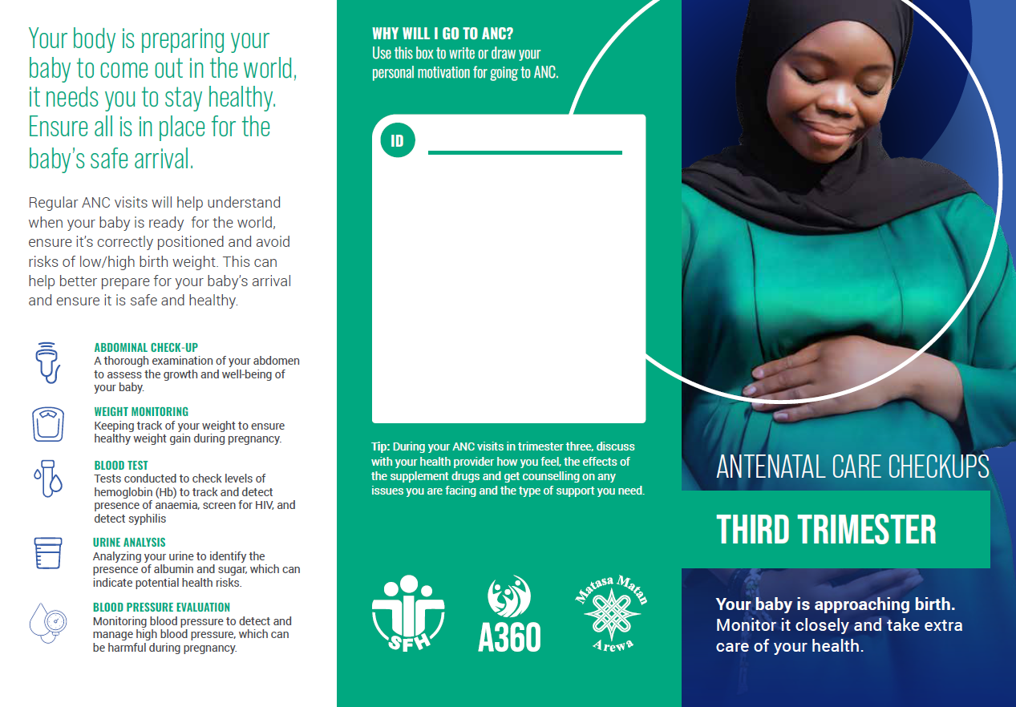
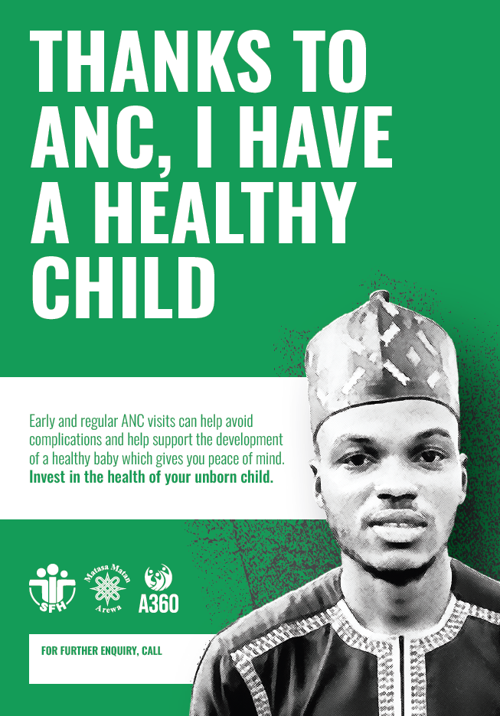
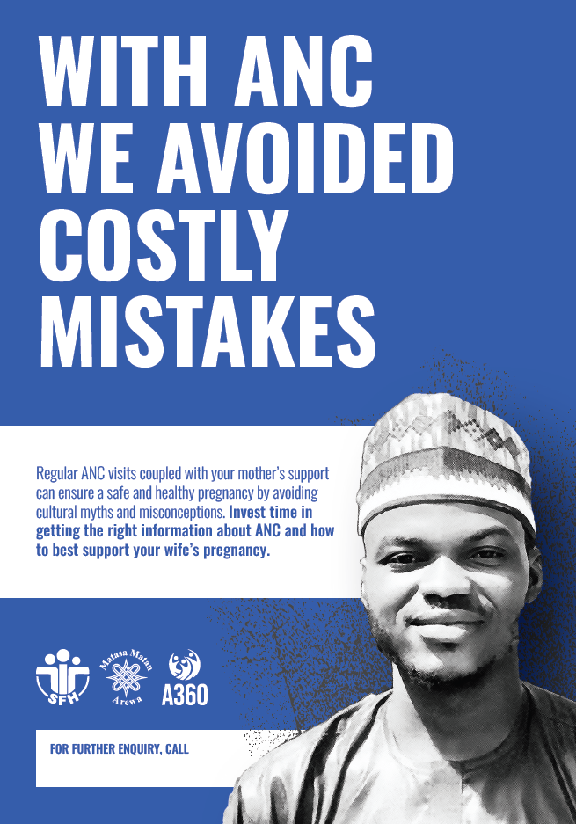



Increasing postpartum family planning among married adolescents in northern Nigeria
AUTHORS
Mary Phillips¹, Abednego Musau², Roselyn Odeh³
Author Affiliations:
1 Population Services International, Washington, DC
2 Population Services International, Nairobi, Kenya
3 Society for Family Health, Abuja, Nigeria
BACKGROUND
Postpartum family planning (PPFP) is a proven approach for increasing contraceptive use.
Adolescents give birth at very high rates in Nigeria, but they are less likely to access prenatal services, less likely to give birth in a health facility, less likely to use modern contraception that older women.
High rates of birth suggest PPFP is an opportunity to reach married adolescent girls with FP.
Improving ANC access and encouraging facility birth and FP is one possible way to increase contraceptive use among married adolescent girls and reduce teenage pregnancy.
Girls in the intervention group were 1.7 times more likely to attend ANC
(IRR= 1.66; 95% CI: 1.50,1.84 p<0.001)
Girls in the intervention group were 2.4 times more likely to give birth in a health facility
(IRR= 2.36; 95% CI: 1.93, 2.89; p<0.001)
INTERVENTION
Girls aged 15–19 pregnant or at risk of pregnancy attended pre-ANC sessions covering ANC benefits, birth preparedness, healthy pregnancy, and PPFP.
Sessions were led by mentors and ANC providers, who referred pregnant girls to care.
Husbands participated in discussions on ANC and PPFP benefits.
Providers received training on PPFP counselling and were encouraged to consistently share messages on birth spacing and PPFP uptake during ANC visits.
Fig 3. Exposure to the intervention was correlated with longer-lasting, more efficacious methods (p<0.001)
Examples of communication materials used with pregnant adolescents (left) and their husbands (right).
Fig 4. Exposure to the intervention was correlated with a more rapid adoption of contraception postpartum (p=0.012)
METHODS
Quasi-experimental cohort study with intervention (n=454) and comparison group (n=392)
9 (5 intervention, 4 comparison) local government areas in 2 states of Nigeria (Kaduna and Jigawa)
Eligible participants were married girls 15-19, residing in study area, not using contraception or pregnant <25 weeks
Survey conducted postpartum assessed differences in health-seeking behaviors among the two groups
Statistical analysis includes: univariate descriptive statistics and multivariate modified Poisson regression with robust standard errors comparing outcomes between intervention and comparison groups.
CONCLUSION
Postpartum family planning is an effective way to reach adolescent girls in areas where birth rates are already high.
Targeted interventions are needed to address this vulnerable group and overcome existing barriers to both ANC access and contraceptive uptake.
Promising elements include making ANC relevant for girls, working with husbands, and including messaging on child spacing throughout the antenatal period.
More, high quality data is needed to understand postpartum FP uptake trends by age in LMICs.
RESULTS
Fig 1. Demographics
VISIT US
PSI.ORG
LIKE US
PSIHEALTHYLIVES
FOLLOW US
POPULATION-SERVICEINTERNATIONAL

