Slide 1


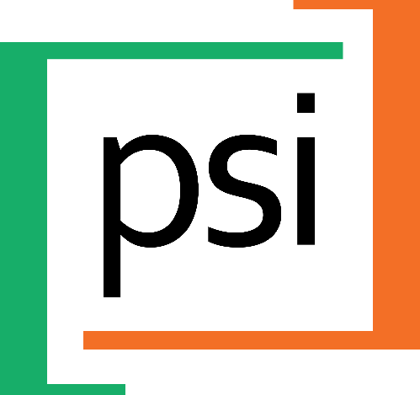
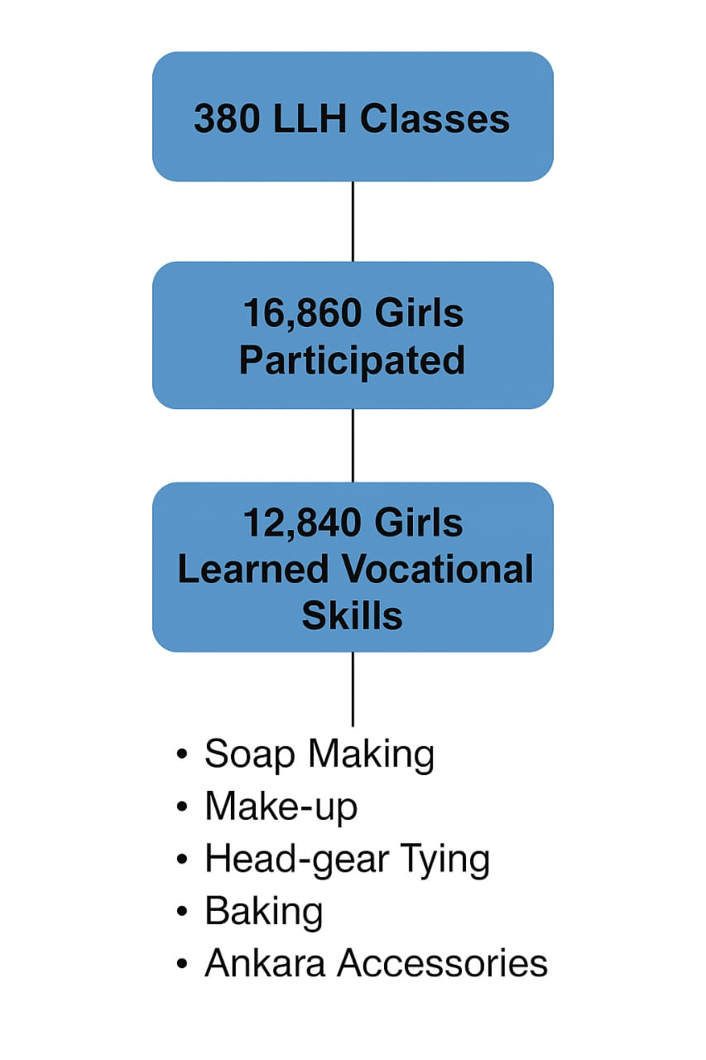
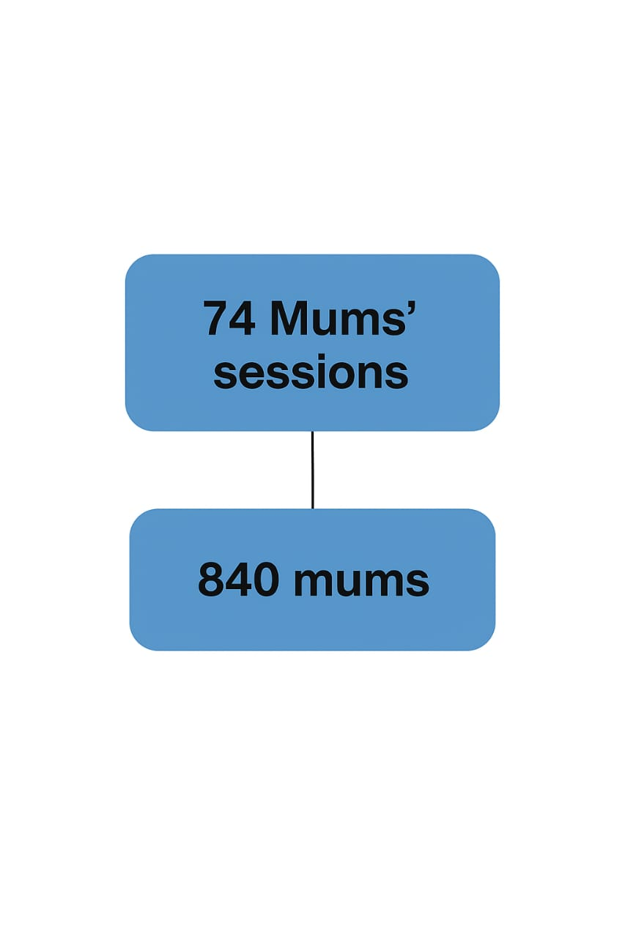
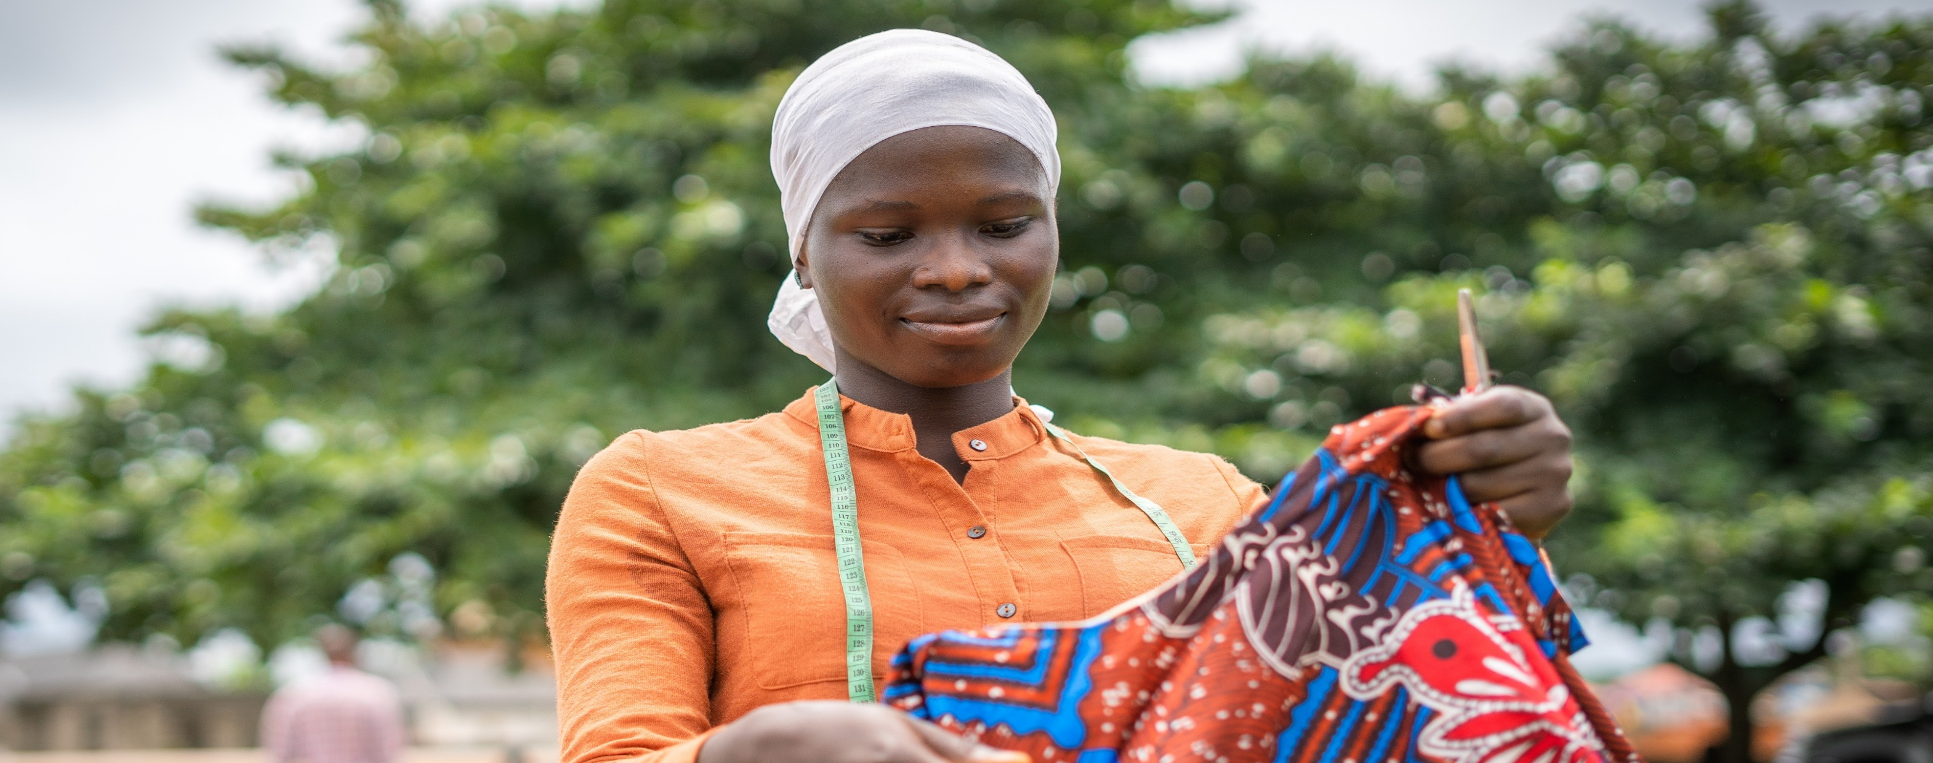
The Role of Economic Empowerment of Adolescent Girls and Mums’ Session Approaches in Breaking Barrier to Access of ASRH by Adolescent Girls 15-19years in Ogun State, Nigeria
AUTHORS
Olusola O. Oyewole*, Roselyn Odeh
Author Affiliations:
Society for Family Health A360 Nigeria
BACKGROUND
Adolescents make up 30.7% of the population of Ogun State
Mean age first sexual intercourse: 15 and 16
Risky behaviours: 96% have multiple partners, 95% have unprotected sex.
15% of adolescent girls (15-19 years) have ever been pregnant
Access to ASRH services are very limited due to unfriendly public health facility setup, providers’ bias, inadequate number of AYRH trained personnels.
Adolescent Girls Contraceptive Use
METHODOLOGY
Goal: Increase contraceptive use among adolescent girls aged 15-19 years.
Activities
Economic Opportunity: learning of vocational skills
Life, Love and Health Classes offered SRH counselling, mentorship, life skills.
Meetings with Mothers of adolescent girls in the communities, to increase buy-in for ASRH and educate them on strengthen mother-daughter relationship
The program evaluation tools for this project includes redeemed referral cards, family planning registers and service provider tracking booklets.
Demand
Supply
Continuation
Reaching adolescents and young people through targeted capacity building, together with engaging communities and local businesses, has enhanced access to Adolescent Sexual and Reproductive Health (ASRH) services by creating supportive environments and strengthening community involvement.
Mobilizers
Mum Sessions
LLH Events
Youth Friendly Providers
Counselling Protocol
Hub and Spoke Model
Supportive Supervision
Follow Up
RESULTS
CONCLUSION
Leveraging on proven high impact ASRH activities such as the Mums’ session has been seen to be effective as it has fostered communal support and acceptability for ASRH and thus creating enabling environment for ASRH services.
The vocational skills approach as an entry point has also yielded great number of referrals and improved access to SRH information, counselling and contraceptive use in the designated health facilities in Ogun State

