Slide 1
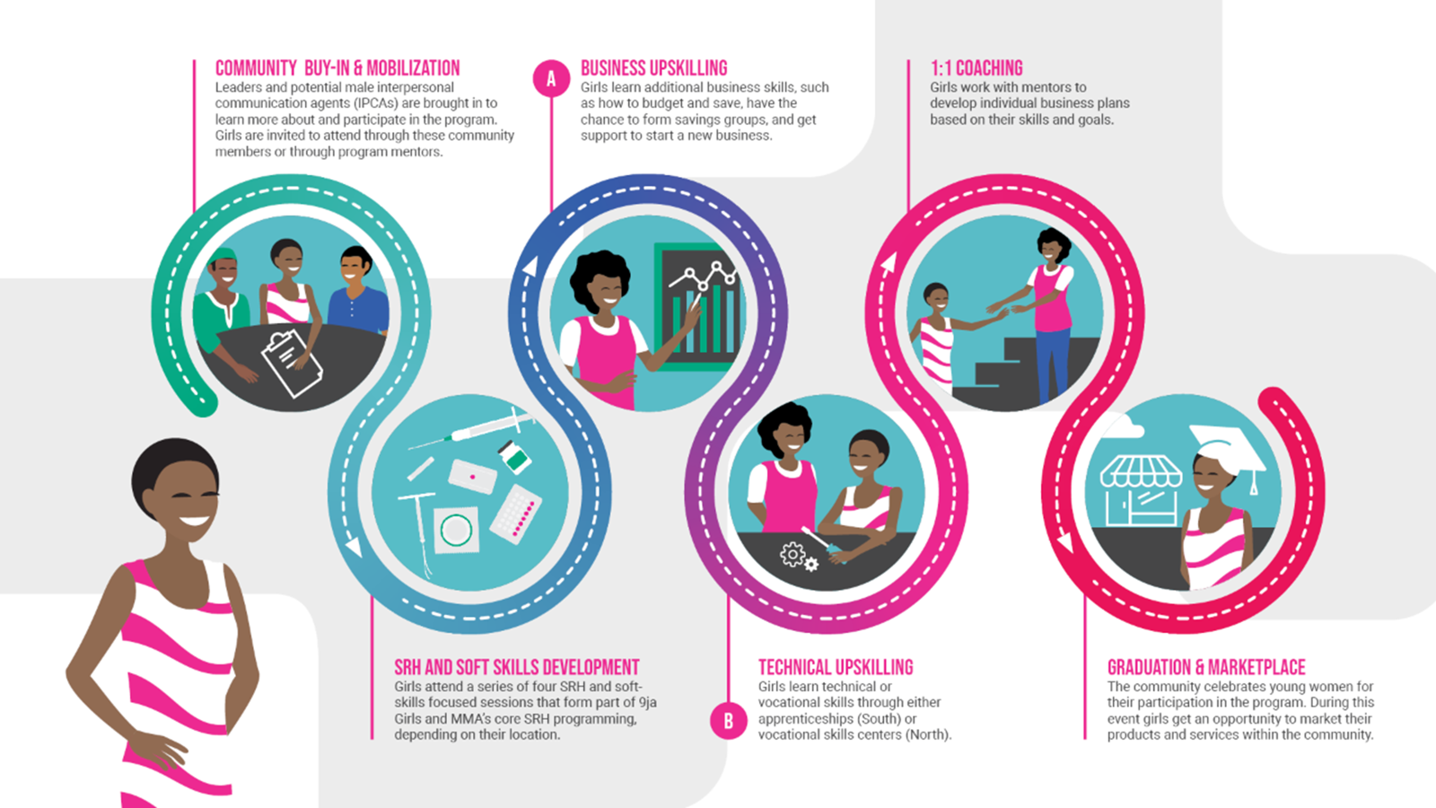




Delivery of effective integrated SRHR and economic empowerment programming for adolescents: recommendations from an evaluation of three integrated interventions
AUTHORS
Meghan Cutherellª, Roselyn Odeh^{b}, Joy Ede^{b}, Seyoum Atlie^{c}, Mary Phillipsª
Author Affiliations:
ª Population Services International, Washington, DC, US; ^{b} Society for Family Health, Abuja, Nigeria; ^{c} Population Services International Ethiopia, Addis Ababa, Ethiopia
BACKGROUND
Adolescent girls are at a critical life stage and establishing healthy behaviors is essential for their growth and development.
An established body of evidence suggests programming for adolescent girls should be holistic and address the various and intersecting barriers they face.
Health and economic well-being are connected, with poor outcomes in one area influencing declines in the other.
Despite this known link, there is little established evidence on what works to integrate SRHR and economic empowerment programming for adolescents.
RESULTS [CONT.]
Among unmarried AGYW in southern Nigeria there was also a three-fold increase in intent to use contraception in the future among those not currently using in the intervention group.
Ethiopia did not show a significant difference, influenced by high rates of contraceptive use among both cohorts at baseline.
Table 1: Current Use of Modern Contraception Among Married or Sexually Active Unmarried Participants
Ethiopia
 |  | Baseline |  | Endline | Difference | P value
Intervention |  | 75.9% |  | 80.2% | +4.3%
Comparison |  | 70.7% |  | 77.2% | +6.5%
Difference- in- Difference |  |  |  |  | -2.2% | P=0.1689
Intervention | 35.1% |  | 89.9% |  | +54.8%
Comparison | 38.9% |  | 52.6% |  | +13.7%
 | Difference-in-Difference |  |  |  | +41.1% | P=0.004
Intervention | 63.5% |  | 50.5% |  | -13.0%
Comparison | 80.2% |  | 48.5% |  | -31.7%
 | Difference-in-Difference |  |  |  | +18.7% | P=0.6
INTERVENTION DESCRIPTION
The Adolescents 360 (A360) project layered economic empowerment components onto its existing SRHR interventions for adolescent girls aged 15-19.
The project piloted these integrated models across three geographies – Ethiopia, southern Nigeria, and northern Nigeria.
Northern Nigeria
Southern Nigeria
Figure 1: Intervention User Journey Example, Nigeria
IDIs demonstrated that girls understood the relevance of accessing SRHR services in relation to pursuit of their goals.
Among girls not currently using, they indicated that they understood how it could be important for them in the future.
For family planning, it has many benefits… there are also some goals you want to achieve, sometimes if you are always giving birth, you would not be able to achieve those goals, so there is a need to be on family planning.
-AGYW, Age 19, Kaduna state, northern Nigeria
If I did give birth after a year of delivery, my child would be an infant. So I wouldn’t be able to do income-generating work. But now because my child is young and I’m using contraceptives, I can do work and make my own money.
-AGYW, Age Unknown, Oromia region, Ethiopia
Maybe when I’m not ready to get pregnant now, I can adopt one of the contraceptive method. Without it now if I should get pregnant there will no way I get to my goals easily.
-AGYW, Age 20, Ogun state, southern Nigeria
METHODS
We employed a mixed methods quasi-experimental design with an intervention group receiving the integrated intervention and a similarly sized comparison group receiving only the SRHR intervention.
Baseline quantitative survey prior to intervention exposure and an endline nine months after for the same participants.
Difference in difference analyses conducted for quantitative survey data, adjusting for control variables.
In-depth interviews conducted with 70 AGYW across the geographies at endline to assess participant experience with the intervention.
Thematic analyses conducted through two rounds of inductive / deductive coding process to generate primary themes.
PROGRAM IMPLICATIONS
Consistent emphasis on SRHR throughout the combined intervention (such as in northern Nigeria) offered multiple opportunities for girls to reflect on and access services, contributing to greater uptake.
In contrast, using SRHR only as an entry point into the economic empowerment component (such as in Ethiopia) could have resulted in more limited additive value to the combined intervention.
Complexity of working with unmarried AGYW, whose contraceptive needs map be more episodic, requires a unique approach. Future intent to use may be a meaningful interim outcome in contexts where immediate use is less likely.
RESULTS
Greatest program effect demonstrated in northern Nigeria (among married AGYW) with a 41.4pp difference in the increased contraceptive use between intervention and comparison groups.
Southern Nigeria also significant program effect on contraceptive use among sexually active unmarried AGYW, however this was driven by a greater decrease in use in the comparison group.
KEY INSIGHT: Achieving multi-dimensional outcomes through integrated programming requires consistent reinforcement of all core messages – especially SRHR – and a clear understanding of the distinct needs of different sub-populations
VISIT US
PSI.ORG
LIKE US
PSIHEALTHYLIVES
FOLLOW US
POPULATION-SERVICEINTERNATIONAL

