Slide 1
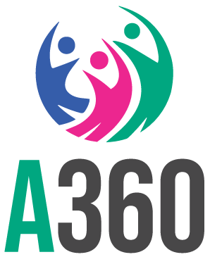

Mobilizing key influencers to promote contraceptive use among rural adolescent girls: Lessons from Health Extension Workers in the agrarian regions of Ethiopia
AUTHORS
Winnie Musubikaª, Seyoum Atlie^{b}, Amsalu Kale^{b}
Author Affiliations:
a Population Services International, Kampala, Uganda
b Population Services International, Addis Ababa, Ethiopia
BACKGROUND
Rural, married girls in Ethiopia are a high-need group who are often overlooked for contraceptive services.
HEWs engaged a wide range of influencers, with nearly all working with the WDA
Lower mCPR
Higher unmet need
Higher 12-month discontinuation rates
36.5% for ages15-19, compared to 50.6% for ages 20-24
20.5% for ages15-19, compared to 18.5% for ages 20-24
45% for ages 15-19, compared to 35% for ages 20-49.
Smart Start supports married girls to access contraception information and services through goal-based family planning counseling and community engagement.
It is being scaled to 11,000 health posts.
Health Extension Workers (HEWs) are the front-line implementers.
Demand generation is critical but HEWs are overloaded.
Mobilizing community influencers can reduce HEW workload and strengthen demand generation for married adolescents.
However, this work is inconsistent and lacks structured approaches.
This study assesses influencer engagement by Health Extension Workers and proposes improvements for scaling demand generation in adolescent reproductive health.
Although WDA members and Kebele leaders were engaged by the most HEWs, mothers and mothers-in-laws were reached in greater frequency by those HEWs who did engage them (17 and 8 per month vs. 23 and 36 per month).
Group dialogues and household visits were the most common strategies for engaging influencers
TYPES OF KEY INFLUENCERS
Women’s Development Association (WDA) members, Kebele (village) administration leaders, volunteers, religious leaders, community elders, and household-influencers such as husbands and mothers-in-law.
METHODS
Location: 28 woredas across Sidama, Amhara, Oromia, and South Ethiopia
Participants: 96 HEWs, with >6 months tenure, a focus on agrarian settings where Smart Start is active
Data collection: Face-to-face interviews using a structured survey tool
Data measures: Demographic information, influencer engagement strategies, types of influencers reached, challenge, benefits, and supports requests
Data analysis: Descriptive statistics and bi-variate analysis (chi-square and t-tests) to examine relationships between influencer engagement strategies and HEW characteristics
Barriers to engagement
Religious resistance
Misinformation
Distance
Enablers to engagement
Strong community ties
HEWs training in community mobilization
97% of HEWs requested further capacity building and support for informal engagement activities.
RESULTS
Respondent Demographics
Most respondents were married, between ages 26-30, with a Diploma
CONCLUSION
HEWs recognize the value of community influencers, but current strategies are unevenly applied.
More could be done to engage mothers-in-law, traditional leaders, and religious figures who uphold social norms.
HEWs need targeted capacity-building in social and behavior change, advocacy, and engagement strategies to reach community-based influencers.
Resources and strategies must address cultural norms that shape resistance to family planning use, including religious beliefs, negative masculinities, and misinformation.
Yes
No
<25
26-30
>40
31-35
Degree
Diploma
36-40
Certificate
Level 4
VISIT US
PSI.ORG
LIKE US
PSIHEALTHYLIVES
FOLLOW US
POPULATION-SERVICEINTERNATIONAL

