Slide 1



Delivery of effective integrated SRHR and economic empowerment programming for adolescents
Meghan Cutherell, MPH
Sr. Program Manager, Adolescents 360
PSI
Notes:
Notes:
Good afternoon everyone I am grateful for the opportunity to speak with you today.
I’m going to present today on recommendations regarding the integration of SRH and economic empowerment, using evidence from an evaluation of three integrated interventions.

Slide 2

BACKGROUND:
An established body of evidence suggests programming for adolescent girls should be holistic and address the various and intersecting barriers they face.
Health and economic well-being are connected, with poor outcomes in one area influencing declines in the other.
Despite this known link, there is little established evidence on what works to integrate SRHR and economic empowerment programming for adolescents.
The Adolescents 360 (A360) program evaluated the effectiveness of three integrated interventions to support economic empowerment and SRH for adolescent girls.
Notes:
Notes:
The community of practice has for a long time been saying that holistic programming is a recommendation.
We know that in particular integrating health and non-health areas such as economic well being can have many benefits because health and economic well-being are connected.
However, even though we are aware that integration of these areas is recommended, the evidence on how to do so for adolescents is limited.
I will share briefly about an evaluation conducted through the A360 program on the effectiveness of three integrated economic empowerment and SRH interventions for girls.

Slide 3
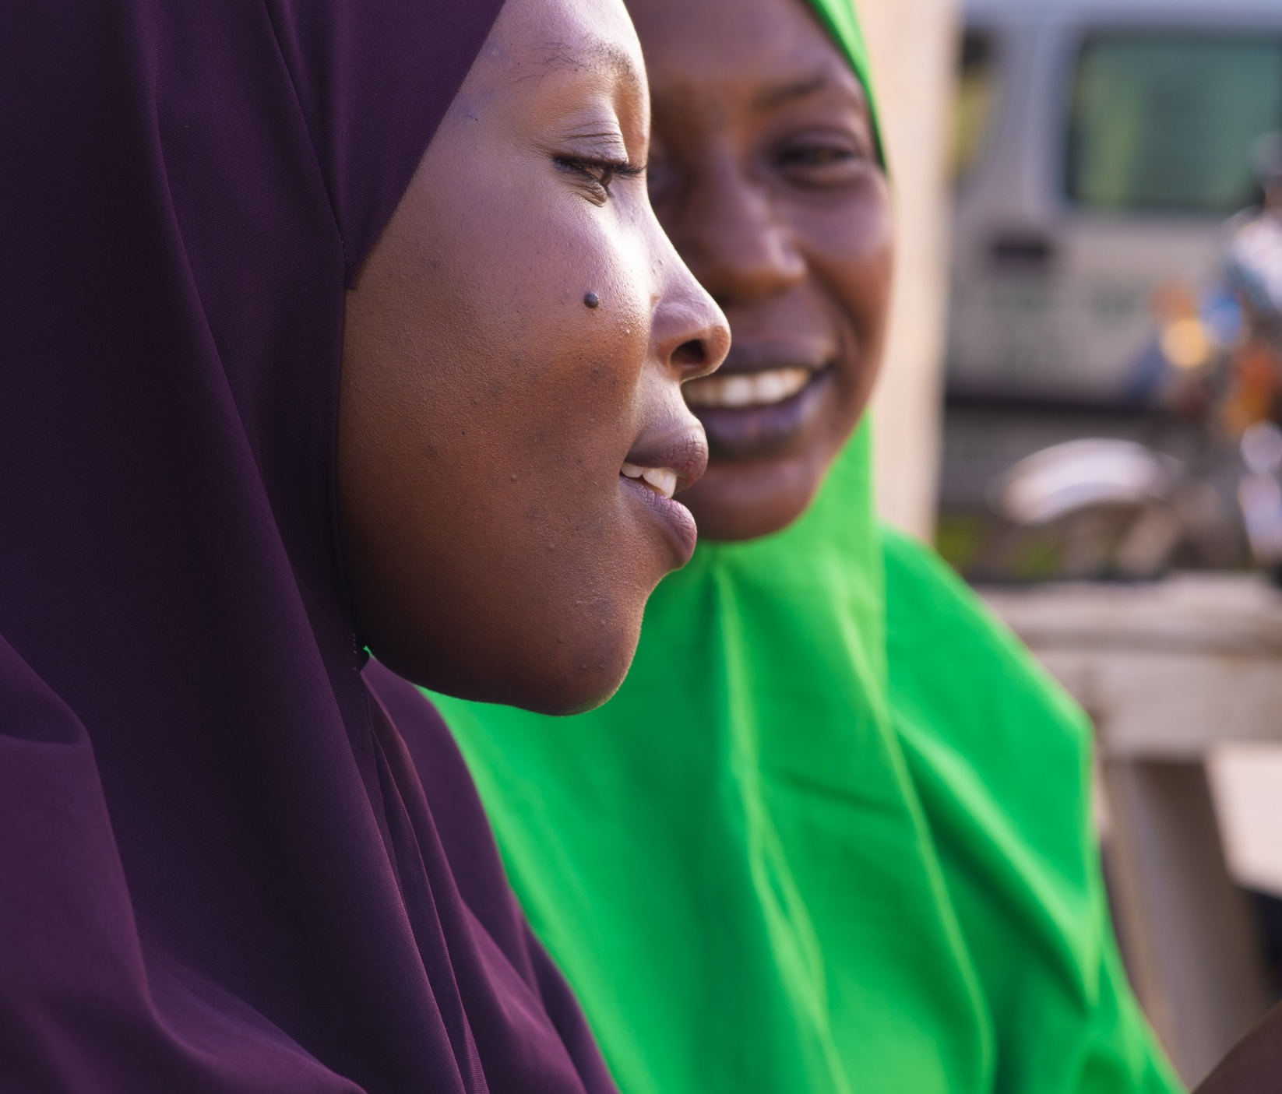
METHODS:
Mixed methods quasi-experimental design with an intervention group receiving the integrated intervention and a similarly sized comparison group receiving only the SRHR intervention.
Baseline quantitative survey prior to intervention exposure and an endline nine months after for the same participants.
In-depth interviews conducted with 70 AGYW across the geographies at endline to assess participant experience with the intervention.
Main Research Question: Does layering economic empowerment components amplify the impact of the SRH intervention and what are the mechanisms for successful integration?
Notes:
Notes:
To evaluate the effectiveness of these interventions we conducted a quasi-experimental study with two groups.
The intervention group received the integrated intervention and the comparison group received the original SRH intervention.
The evaluation included both a quantitative survey and qualitative data collection.
In this green box I wanted to just emphasize this point so it is clear. The way the evaluation was set up was to intentionally understand the additive value of the economic empowerment components in terms of their ability to amplify SRH outcomes, alongside other economic and secondary agency related outcomes.

Slide 4
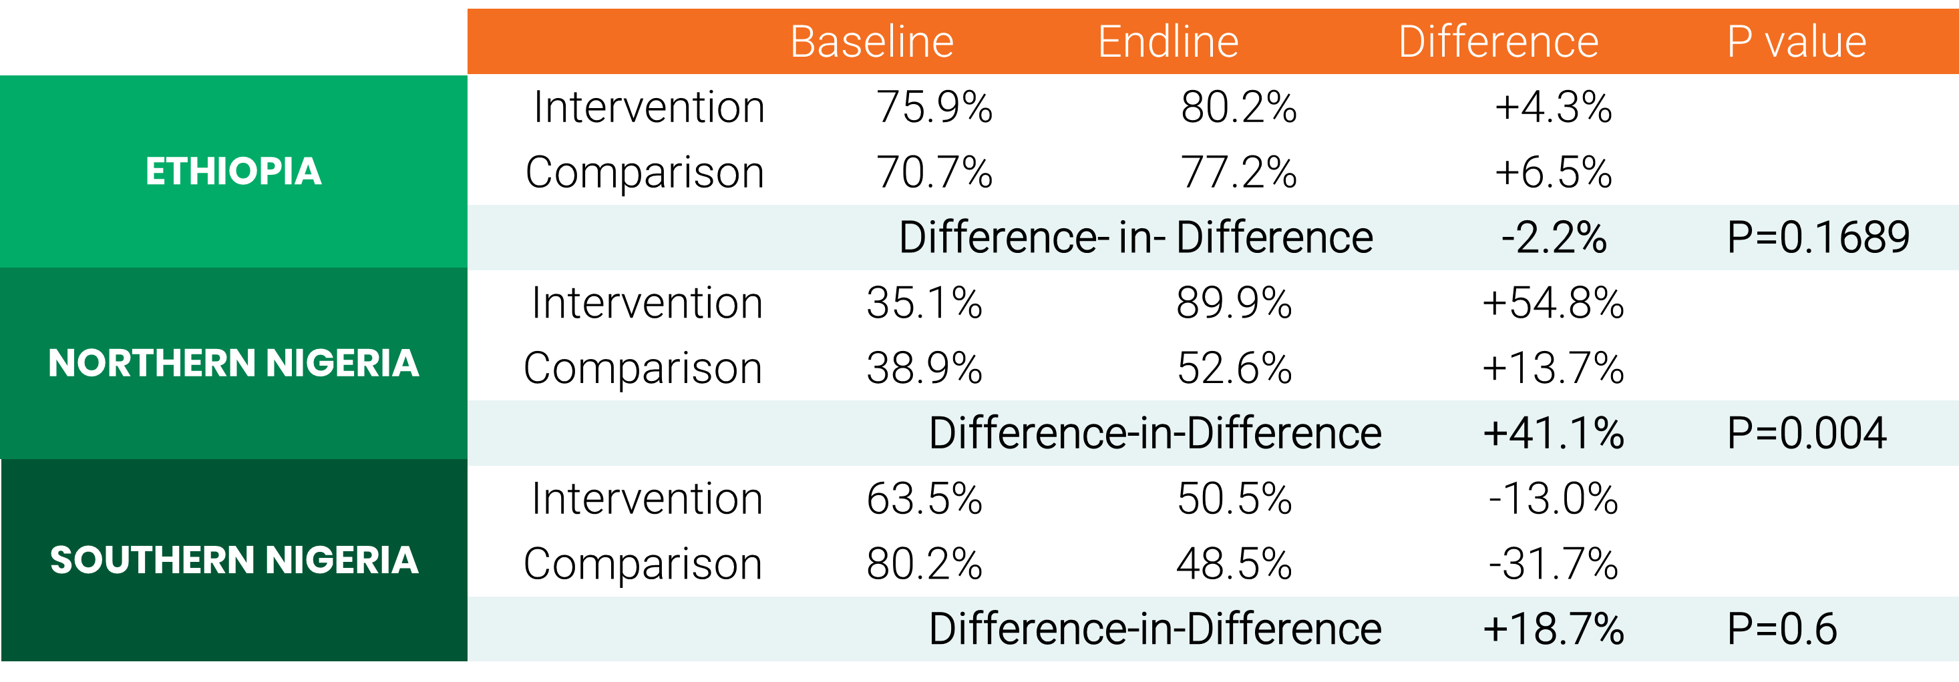
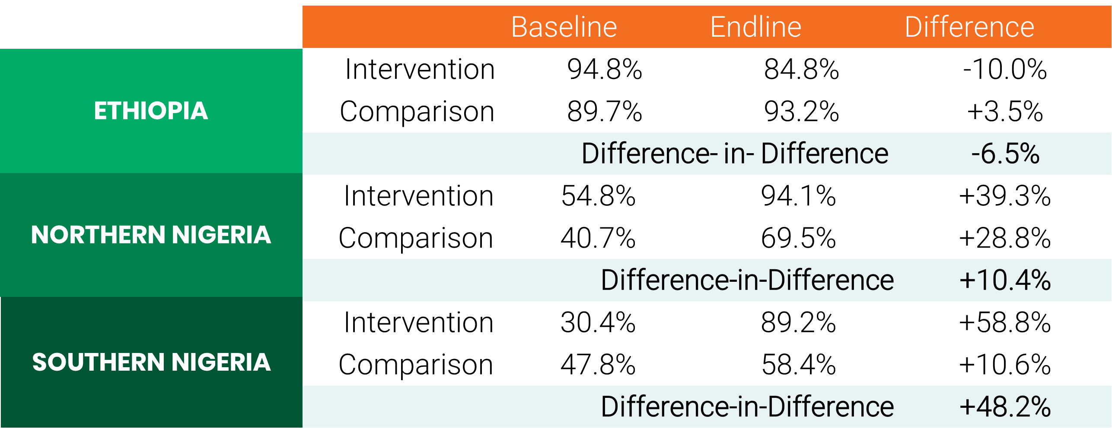
FINDINGS
Current use
Intent to use
Notes:
Notes:
Though the evaluation was mixed methods, I’m choosing just to highlight the two primary quantitative indicators and there is further qualitative information on my poster.
In terms of current contraceptive use, northern Nigeria where we worked only with married adolescent girls, had the largest program effect and nearly 90% of girls in the intervention group were using contraception at endline.
Ethiopia and southern Nigeria had mixed results in current contraceptive use, though southern Nigeria where we worked primarily with unmarried girls, saw strong program effect on intent to use.
Ethiopia’s data had very high baselines which is partially why there was not a positive program effect on either indicator.

Slide 5
Lessons learned
MESSAGES AROUND GOALS PROVIDE CRITICAL LINKS BETWEEN ECONOMIC ACTIVITY AND srh
ONCE IS NOT ENOUGH – SRH MESSAGES MUST BE REINFORCED MULTIPLE TIMES.
Impact might not be amplified with already well served populations
UNMARRIED ADOLESCENT POPULATIONS WHO DON’T HAVE IMMEDIATE NEED PRESENT COMPLEXITIES
Current use may not be the best indicator of success vs. other intermediary outcomes
Notes:
Notes:
I want to highlight five key lessons
One of the key ways that A360 was able to effectively link these two program areas was through messages that positioned contraception as a tool that can support girls to achieve their goals. This was a bridge to integrate health and non-health areas without it feeling artificial to participants.
But at the same time these messages couldn’t just be said once at program outset for it to be effective. Particularly for our Nigeria interventions these messages were reinforced multiple times over the course of the integrated intervention and we saw that when they were reinforced, they were internalized better.
In Ethiopia we didn’t see effect, but this was primarily because girls had such high levels of contraceptive use and intent already at the program outset. This doesn’t mean that integration of the programming wasn’t useful or needed, but the implication here is that we might not always assume that integration will amplify SRH outcomes if the population is already well served and has high utilization of services.
In southern Nigeria working with unmarried girls we saw some additional complexities. What doesn’t come out in this presentation is the varying rates of sexual activity among participants between baseline and endline, reinforcing that unmarried girls have evolving and changing needs and therefore may need a unique approach that recognizes how sub-groups of unmarried girls will have differing immediate needs.
And following on from that there is the acknowledgment that current use may not be the best indicator of success. Intent to use was a metric that we incorporated but also belief in the relevance of contraception and contraceptive knowledge. These indicators maybe have a bad reputation as not being meaningful enough but for girls who don’t have those immediate needs or relevance for use because they are not active, these other intermediary outcomes can help us determine whether we are preparing them to access services timely when they are ready.

Slide 6
THANK YOU

