Slide 1




Harnessing Faith-Based Advocacy: Assessment of the Impact of Young Religious Influencers on Contraceptive Acceptance Among Religious Leaders in Northern Nigeria
Authors
Aliyu Abdulaziz Aliyu*, Roselyn Odeh
aaliyu@sfhnigeria.org
International Conference on Family Planning, Bogota Colombia 2025
November 3-6, 2025

Slide 2

Introduction
In Northern Nigeria, deep-rooted religious and cultural beliefs shape perception of family planning (FP)
Established faith leaders holding decisive influence, yet direct engagement with them often falters due to generational and theological rigidity.
Adolescents 360 (A360) introduced a breakthrough model by empowering Young Religious Influencers (YRIs) to bridge faith and evidence to champion FP dialogues
Approach leverage YRIs' dual credibility with traditional leaders and openness to modern health perspective.

Slide 3

Methodology
Conducted a mixed-methods study using a pre and post intervention design, combining qualitative and quantitative approaches
45 religious leader (30 Muslim leaders & 15 Pastors) from Dala & Fagge communities where simple random selected from participant engage between January and September 2024.
Pre-intervention data was collected before YRI engagement; follow-up data collected 3-6 months post-intervention.
Quantitative analysis utilized paired t-test and multivariate regression
Qualitative data were analysed thematically in Nvivo to capture shifts in theological framing and narrative perspectives.

Slide 4
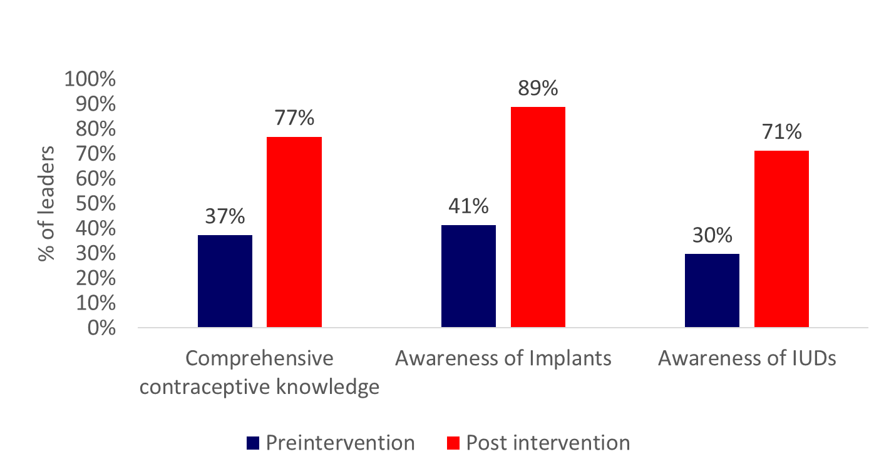
Results
Comprehensive contraceptive knowledge increased by 40%, overall and for LARC methods

Slide 5
Results
Larger increase for muslim leaders compared to Christian leaders
Comprehensive contraceptive knowledge increased by 40%, overall and for LARC methods

Slide 6

Qualitative insights suggested a significant theological shift with 78% of the religious leaders reinterpreting faith teaching, Muslim Imams invoking tarbiyya and Christian
Pastors emphasizing biblical stewardship and responsible parenthood to frame FP as spiritually aligned and socially responsible.
An increase from 11% to 73% of religious leaders initiating FP discussion within their congregants
Result

Slide 7
YRIs’ success stemmed from its near-peer engagement dynamic, faith-aligned framing of scientific information, and a phased dialogue approach
Fostered respectful theological reflection, reduced resistance, and enabled religious leaders to publicly endorse FP within their faith context.
Findings underscore the value of engaging “bridge figures” within religious hierarchies especially emerging male and female scholars as a sustainable strategy to foster faith aligned dialogue and guide inform reproductive choice

