Slide 1



FROM ACCESS TO AGENCY: Strengthening Quality and Client-Led Contraceptive Services for Adolescent and Youth in Ethiopia
Dr. Bekele Belayihun, PhD
Director, Evidence and Learning, PSI Ethiopia

Slide 2

BACKGROUND: ADOLESCENT GIRLS IN ETHIOPIA
Prevalence of early marriage
Impact of early marriage
School dropout: Many girls experience school dropout due to early pregnancies
Health risk : Early marriage contributes to significant health risks due to unintended pregnancies.
Economic opportunity: Limited education reduces economic opportunities for married adolescent girls.
High unmet contraceptive needs lead to repeated pregnancy
Challenges in accessing SRH services hinder informed decision-making for girls.
Access issues:
Add statistic here on how common?
Notes:
Early marriage significantly impacts the lives of adolescent girls in Ethiopia, leading to various negative outcomes that affect their health and future opportunities.
The link between early pregnancies and school dropout is strong, as many girls are forced to leave school to care for their children, limiting their educational and economic prospects.
Limited access to sexual and reproductive health services exacerbates the challenges faced by adolescent girls, preventing them from making informed choices about their reproductive health.
Unintended pregnancies pose significant health risks for adolescent girls, often leading to complications and further entrenching them in cycles of poverty and disadvantage.

Slide 3
Challenges in Accessing Sexual Health Services
Limited Access:
Many girls struggle to reach health facilities providing services.
Lack of Tailored Counseling:
Youth-friendly counseling is often not available for clients.
Respectful Care:
Girls frequently report disrespectful treatment from service providers
Inadequate Information:
Information on contraceptive options is insufficient or unclear.
High Unmet Need:
Many young girls have unmet contraceptive needs affecting choices.
Cultural Barriers:
Societal norms often prevent girls from seeking sexual health services.
Service Quality:
Inconsistent service quality impacts girls’ experience accessing health services.
Contraceptive Uptake:
Limited awareness leads to low adoption of contraceptive methods.

Slide 4

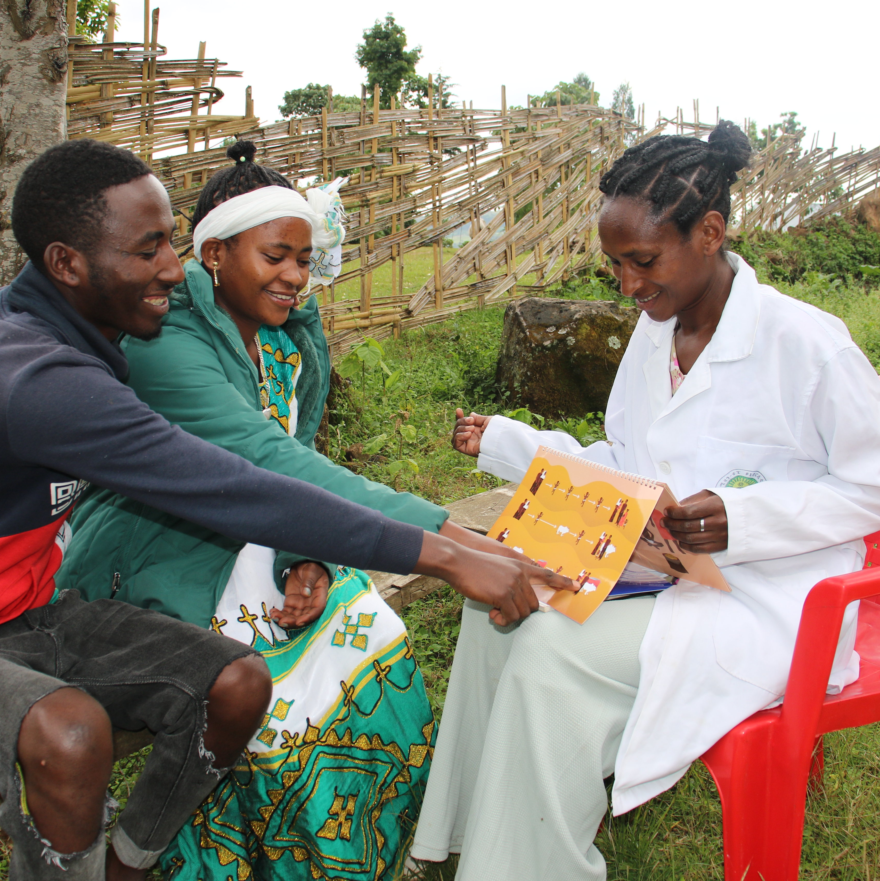


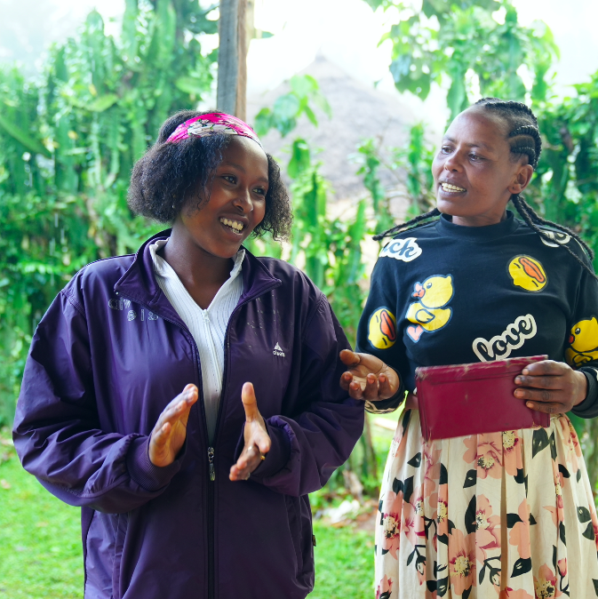
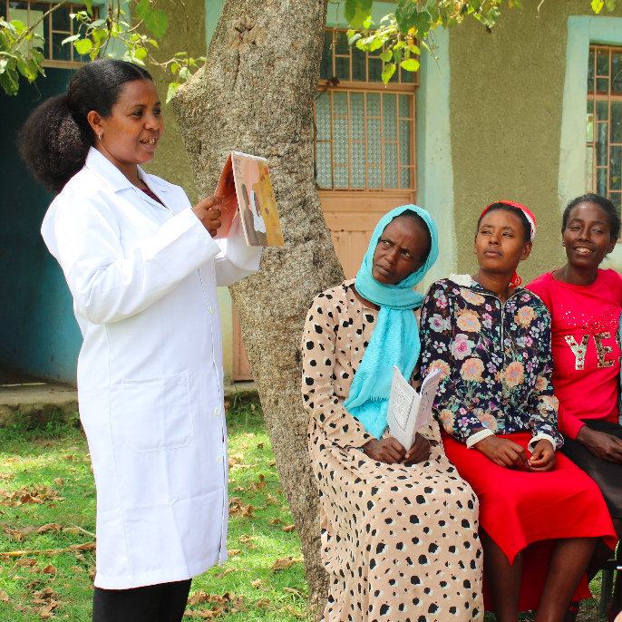
INTERVENTION OVERVIEW: SMART START
Smart Start Initiative
Smart Start aims to improve SRH for adolescents. Smart Start uses financial planning as an entry point to discuss reproductive health with married AGYW and their husbands, fostering joint decision-making to reach their economic goals.
Couple-Centered Counseling
The initiative fosters joint decision-making between married AGYW and their husbands through counseling.
1:1
With Couples
In Small Groups
Youth engagement:
Involve young gills actively in contraceptive decision-making process and program
Respectful care:
Ensure that healthcare providers treat adolescent girls with dignity and provide clear communication
Community outreach:
Implement comprehensive outreach program to raise awareness of SRH service
Continuous education:
Provider ongoing education on contraceptive method and reproductive health to empower young women
Community Engagement
Community mobilizers, including WDAs members and kebele and traditional leaders, engage girls and connect them to timely health services.
Integration and Scale
Smart Start is integrated into Ethiopia’s public health system with over 9,000 health posts involved.
Delivered by HEWS via home visits and health posts, Smart Start is scaled across Ethiopia’s public health system.
Notes:
“Smart Start is designed to improve reproductive health among married adolescent girls and young women.
“Smart Start is a program developed under the Adolescents 360 project to help married adolescent girls and young women make informed reproductive choices.
It uses financial planning as a starting point to talk about family planning — helping couples see how delaying or spacing births can support their economic and life goals with decisions about when to have children.
The sessions are delivered by Health Extension Workers, either during home visits or at health posts, using engaging visuals and simple analogies that make the discussions relatable.
Smart Start promotes couple-centered counseling, encouraging joint decision-making and shared understanding between partners.
The program is now part of Ethiopia’s public health system, reaching more than 9,000 health posts nationwide.
In 2024, the program expanded with Smart Pathways, a component that supports young married women during preconception and pregnancy, with strong community engagement to ensure timely care.

Slide 5
PROGRAM IMPLICATIONS
Financial counseling is a key component of Smart Start.
Engaging partners enhances decision-making around contraception.
HEWs are vital for program implementation.
The program operates within existing public health structures.
Informed choice is crucial for empowerment.
Youth-centered service delivery models are essential.
Empowering young women leads to better health outcomes.
Institutionalized and scaled across major regions with MOH and PSI Ethiopia support
Implementation within Public Health Structures
Identify the unique needs of adolescent girls.
Involve local leaders and community stakeholders actively.
Provide training on youth-friendly SRH services delivery.
Roll out Smart Start intervention in health posts.
Regularly track implementation and service quality metrics.
Conduct Client Exit Interviews to assess experiences.
Refine approaches based on CEI results.

Slide 6
METHODOLOGY
Three rounds of CEIs were conducted for comprehensive data.
The sample included over 1,413 adolescent girls
2022 (1st round): 402 girls surveyed at 24 health posts
2023 (2nd round): 339 girls surveyed at 60 health posts
2024: Includes participants aged 15-24 years, 672 participants across 92 health posts and 16 health centers
Use of SurveyCTO and Stata for analysis
Revery round maintained IRB through annual renewals and reviews
CEIs EXPLORED
Client demographics
Prior reproductive history
Client experience of care
Quality of Service Delivery
Client engagement with program components

Slide 7
Sampling and Data Collection Process
Step1: Define objectives for data collection process
Step2: Identify target population and sampling frame
Step 3: Develop data collection tools and methodologies
Step4: Train data collectors on processes and ethics
Step5: Collect data from selected participants as planned
Step6: Analyse collected data using statistical software
Step7: Interpret findings and generate reports for stakeholders
Step8: Disseminate results and recommendations to relevant parties

Slide 8
KEY FINDINGS

Slide 9
Demographic Insights from CEIs
75% aged 18–19
84% out of school
57% have ≥1 child
Average age at first birth was 17

Slide 10
Rates of Contraceptive Use, and Quality of service
High Uptake
84% adopted contraception during health visit.
Injectables (70%) were the most common contraceptive choice.
Strong Engagement
96% initiated contraceptive discussions with partners
High Respect
97% of clients felt respected by providers
Empowered Decisions
95% Informed Decisions
Long term Intentions
90% plan to continue chosen method
Notes:
97% of clients felt respected by providers.
Positive client experiences are crucial for continued engagement.

Slide 11
Method Information Index Plus Findings
MII+ improvement
MII+ scores improved across CEI rounds.
Enhanced knowledge leads to better contraceptive use
Information is key to reducing unintended pregnancies.

Slide 12
LESSONS LEARNED

Slide 13

Contraceptive Decision-Making
Autonomy/empower: Girls independently initiate discussions about contraceptive use with partners which leads to better health outcome
Informed Choices: High percentages demonstrate understanding of their contraceptive options, promoting informed choice
Counselling Impact: Youth-centered counselling helps expand girls' life goals and aspirations.
Partner Involvement: A majority engage partners in dialogues before making contraceptive decisions.
Contraceptive Uptake: Majority adopt contraceptives during visits, ensuring informed choice.
Long-term Intent: High intent to continue chosen contraceptive methods for at least a year.

Slide 14
Intention to Continue Contraceptive Use
Trust in healthcare is essential for continued engagement.
High-quality care fosters positive relationships with providers.
Respectful treatment is vital for client satisfaction.
Clear communication enhances understanding and trust.
Effective contraceptive services support future planning

Slide 15
Systems Strengthening for Quality Delivery
ENGAGE:
Involve hews in community outreach activities
Assess:
conduct regular evaluations to measure quality of service delivery
Train:
Provide ongoing training for PROVIDERS ON youth-friendly services
Support:
Offer financial counseling to empower adolescent girls and couples
INFORM:
Improve educational resources on contraceptive options
MONITOR:
Establish continuous feedback systems to inform improvement

Slide 16
Implementation approach
Youth Empowerment: Encourage girls to make informed health decisions independently.
Quality Services: Ensure respectful treatment during health service delivery.
Informed Choices: Increase access to comprehensive contraceptive information.
Community Engagement: Involve families in discussions surrounding contraceptive use to enhances program impact.
Healthcare Connection: Strengthen partnerships between health providers and adolescents.
Accessibility and respect in services are crucial.

Slide 17
Conclusion
Smart Start has improved contraceptive use among adolescents.
Client-centered care is crucial for health outcomes.
Continued scaling of interventions is necessary.
Empowering young women leads to better quality of life.

Slide 18

CALL TO ACTION
Collaboration among stakeholders is essential.
Quality care must be prioritized in services.
Informed choice is crucial for empowerment.
Focus on underserved areas is necessary.
Notes:
Collaboration among various stakeholders is vital for improving reproductive health services and addressing the unique needs of adolescents effectively.
Prioritizing quality care in reproductive health services is critical for ensuring that adolescents receive the support and information they need to make informed choices.
Empowering adolescents through informed choices is essential for fostering autonomy and improving health outcomes in reproductive health.
Addressing the needs of underserved areas is crucial for ensuring that all adolescents have access to the reproductive health services they require.

Slide 19
ACKNOWLEDGMENT
THANK YOU
RISE Funders
RISE Partners
Project Team
Data Collectors
Notes:
Acknowledgment
Talking Point: “Before closing, I’d like to acknowledge our donors, project teams, and dedicated data collectors who made this work possible. Thank you all for your attention — I look forward to your questions and reflections.”

