Slide 1

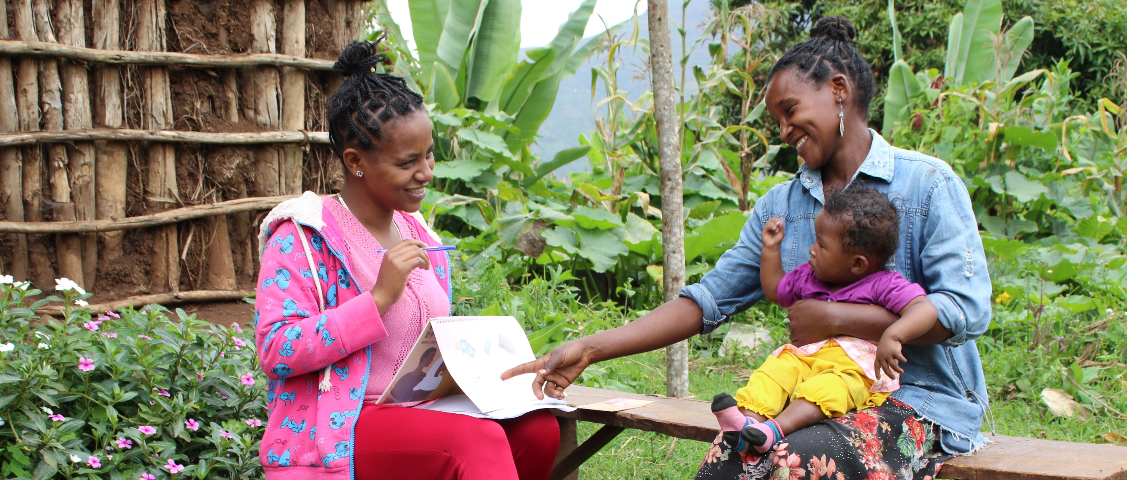



Understanding Barriers and Enablers of Contraceptive Continuation Among Married Adolescents in Ethiopia: Insights from the Smart Start Retrospective Survey
AUTHORS
Seyoum Atlie Beddiluª, Dr. Rahel Demissewª, Mary Phillips^{b}
Author Affiliations:
Population Services International | Ethiopia, Addis Ababa
Population Services International | Washington, DC, USA
BACKGROUND
Contraceptive continuation reduces:
Figure 2: Average 12-month continuation rate increased over time
  Early and repeat pregnancies
  Maternal and infant mortality
  Unsafe abortions
Adolescents 15-19 in Ethiopia experience higher discontinuation rates than women 20-49.
Married adolescents face unique barriers to contraceptive access and continuation:
  Physical distance, cost, and limited knowledge
  Provider bias
  Limited autonomy and restricted movement
Factors affecting continuation
Enablers | Barriers
Active husband participation | Pressure from in-laws to conceive
Personalized, high-quality counselling | Mutual desire to have children
Regular provider follow-up | Peer influence
Key community influencers engagement | Concerns over side effects
Study Aim: Identify continuation rates among adolescent clients and barriers and enablers to continued contraception use.
INTERVENTION
Smart Start is an innovative model that integrates financial planning with family planning, aiming to align contraceptive use with life aspirations among rural married adolescents.
METHODS
Retrospective survey
Study period: Jan 2023 – July 2025
Target population: Girls 15–19 who accessed services ≥12 months prior in rural sites across three regions of Ethiopia
Data sources:
Client records (yellow/family health cards), Tickler box system (for follow-ups and refill tracking), key informant interviews with girls and HEWs, client exit interviews, and routine program monitoring.
Data coded in Excel: visit dates and methods.
Analysis: Descriptive statistics to identify continuation patterns
Quality tracked via commodity monitoring, provider training, mentoring, and care assessments.
Social and cultural factors deeply influence contraceptive decisions.
CONCLUSIONS
Smart Start intervention areas showed higher contraceptive uptake rates among adolescents than national benchmarks.
Strategies that address specific barriers to continue facing married adolescents include: Husband involvement, quality counselling, provider follow-up.
Additional needs include engagement with In-laws and peers, with culturally sensitive awareness strategies to address social pressures facing married adolescents.
RECOMMENDATIONS:
Routine assessment of contraceptive continuation to inform interventions.
Additional quantitative studies on long-term contraceptive patterns and impact on birth spacing, fertility, and reproductive health.
Policies and programs should be tailored to married adolescent girls, promoting autonomy, empowerment, and well-being.
RESULTS
Analysis of the 1,612 client records showed:
57% (919 clients) were using short-term methods (STM) such as oral contraceptives and injectables.
43% (693 clients) were using long-acting reversable contraceptives (LARCs), including implants and intrauterine contraceptive devices.
Fig 2. Method Mix (n=1612)
VISIT US
PSI.ORG
LIKE US
PSIHEALTHYLIVES
FOLLOW US
POPULATION-SERVICEINTERNATIONAL

