Slide 1
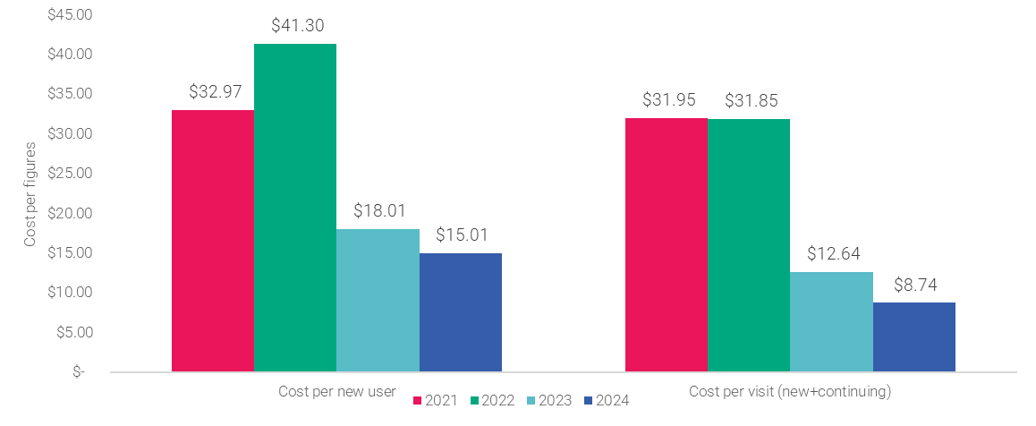
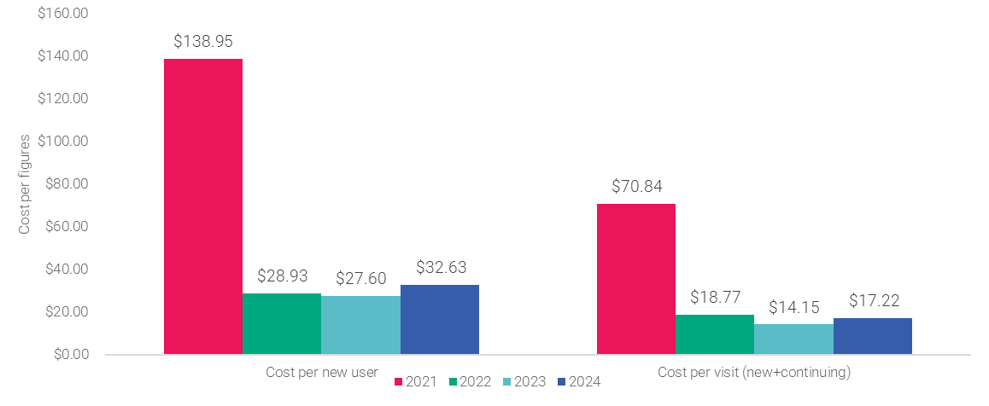


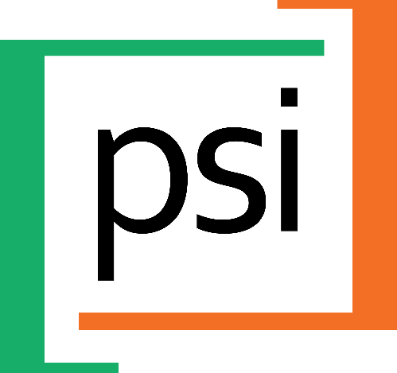
Significant cost reductions were achieved through program scale-up and government integration.
In Northern Nigeria, the cost per new user decreased from $32.97 (2021) to $15.01 (2024), alongside expansion from 20 to 1,450 public health facilities.
Cost per contraceptive visit declined from $31.95 (2021) to $8.74 (2024).
A temporary cost spike in 2022 reflected geographic expansion from southern to northern states and initial investments required to institutionalize implementation within government systems.
Costing Analysis of an Adolescent Contraceptive Uptake Program: Evaluating Financial Efficiency in Ethiopia and Northern Nigeria
AUTHORS
Alexis Coppolaª, Abendego Musau^{b}, Angelica Mercado^{c}
Author Affiliations:
Population Services International, Nairobi, Kenya; ^{b} Society for Family Health, Abuja, Nigeria; ^{c} Population Services Ethiopia, Addis Ababa, Ethiopia; ^{d} Population Services International, Washington DC, US;
BACKGROUND
Achieving population-level impact in adolescent and youth sexual and reproductive health (AYSRH) requires interventions that are both scalable and cost-efficient.
Few programs are supported by detailed costing analyses, limiting efforts to replicate or scale successful models.
This analysis shares mid-term findings from adolescent contraceptive programs in Ethiopia and Northern Nigeria, where interventions were integrated into public health systems to promote sustainability and government ownership.
Conducted in partnership with Avenir Health (2021–2023), the study offers comparative insights on how public-sector scale-up can reduce unit costs and improve financial efficiency—strengthening evidence for sustainable, cost-informed AYSRH programming.
Figure 1: Cost per New User & Contraceptive Visit, Nigeria
RESULTS [CONT.]
In Ethiopia, cost per new user declined from $138.95 (2021) to $27.60 (2023), rising slightly to $32.82 (2024) with program expansion.
In 2021, higher costs reflected start-up investments tied to institutionalizing the program within government systems.
During 2022–2023, costs declined as government-led scale-up improved efficiency and resource use.
By 2024, the introduction of new sites—including pastoralist and Tigray regions—required more intensive technical assistance, temporarily increasing costs due to lower initial productivity.
INTERVENTION DESCRIPTION
In Ethiopia and Northern Nigeria, PSI and local partners supported Ministries of Health to deliver adolescent contraceptive programming through existing public health infrastructure.
Efforts emphasized government-led implementation, with technical assistance focused on training, supervision, data use, and service quality.
The intervention aligned with national strategies and budgets, with costs shared between partners and government.
The costing study captured financial trends across 4,621 health posts in Ethiopia and 1,450 primary health centers in Northern Nigeria, where programming emphasized first-time user outreach, client-centered counseling, and youth-friendly service delivery.
Figure 2: Cost per New User & Contraceptive Visit, Ethiopia
METHODS
Cost analysis was conducted annually across implementation geographies in Ethiopia and northern Nigeria.
Combined top-down and bottom-up methods, incorporating periodic time allocation surveys and transaction-level reviews.
Costs included direct implementation, allocated global costs, and in-kind government contributions.
Costs related to external learning or broader program workstreams were excluded and inflation adjustments made for 2022 and 2023.
Costs were adjusted for inflation (2021–2023) and allocated using proportional weights. Site-level transactions were standardized to avoid duplication.
PROGRAM IMPLICATIONS
This analysis demonstrates that adolescent contraceptive programs become more cost-efficient as they scale, particularly when integrated into public systems.
Across Northern Nigeria and Ethiopia, cost per new user and contraceptive visit declined substantially over three years, showing that government-led delivery with targeted technical support can maximize reach at lower cost.
The dual-method costing approach—combining top-down financial data with bottom-up field inputs—offered a fuller picture of cost trends and key drivers. Leveraging existing government infrastructure (e.g., staff time, facility space) proved critical to efficiency gains.
Findings underscore the need for standardized costing frameworks to enable comparability across programs and countries.
These results provide actionable insights for policymakers and donors pursuing sustainable AYSRH scale-up, reinforcing the value of routine financial monitoring within implementation systems.
RESULTS
Significant cost reductions were observed with scale-up and integration:
In northern Nigeria, cost per new user dropped from $32.97 (2021) to $15.01 (2024), aligned with scale-up from 20 to 1,450 public health facilities.
Cost per contraceptive visit reduced from $31.95 in 2021 to $8.74 in 2024.
The 2022 cost spike in northern Nigeria reflects a transition from southern to northern states as it takes time and resources to launch implementation and institutionalize into government systems.
VISIT US
PSI.ORG
LIKE US
PSIHEALTHYLIVES
FOLLOW US
POPULATION-SERVICEINTERNATIONAL

